Slide 1





Learning Resolution-Invariant Deep Representations for Person Re-Identification
Yun-Chun Chen^{1*}
Yu-Jhe Li^{1,2*}
Xiaofei Du³
Yu-Chiang Frank Wang^{1,2}
¹National Taiwan University
²NTU AI Center
³Umbo Computer Vision

Slide 2
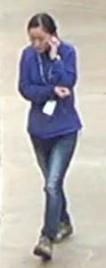
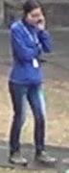
Person Re-Identification (re-ID)
Identify images of the same person captured by different cameras
Same person

Slide 3
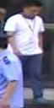
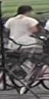


Challenges in Person Re-ID
Occlusion
Background Clutters
Pose Variations

Slide 4
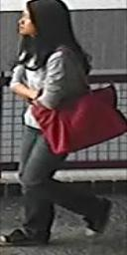




Resolution Variations
Varying distances between the camera and the person of interest
Resize
Short distance → High resolution
Long distance → Low resolution

Slide 5
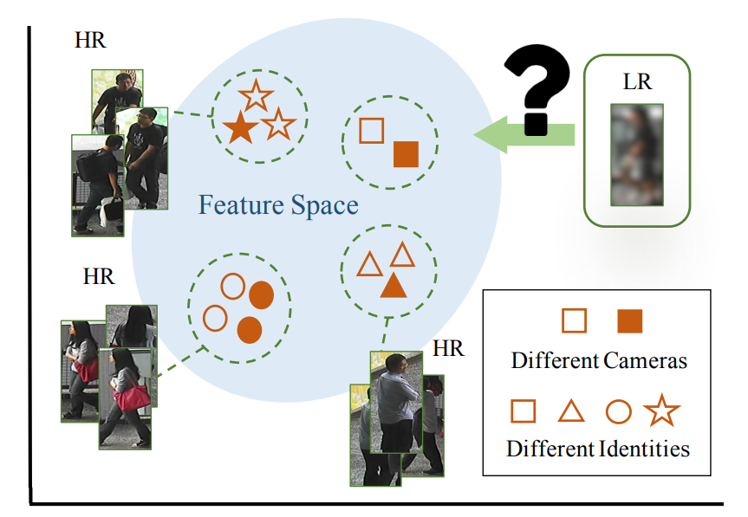
Cross-Resolution Person Re-ID
Resolution mismatch issue due to cross-resolution images.

Slide 6
Existing Strategies

Slide 7
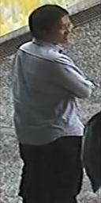

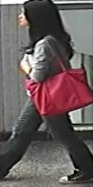
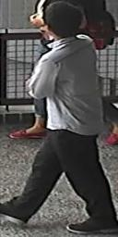
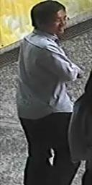
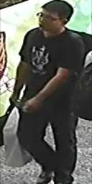
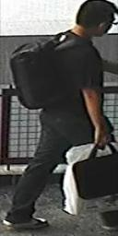
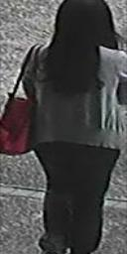
Existing Strategies: SR for Cross Resolution Re-ID
1. Image Recovery
2. Person Re-ID
Query
SR 2x
SR 3x
Gallery
SR 4x
Jiao et al. Deep Low-Resolution Person Re-Identification. In AAAI, 2018.
Wang et al. Cascaded SRGAN for Scale-Adaptive Low Resolution Person Re-Identification. In IJCAI, 2018.
7

Slide 8
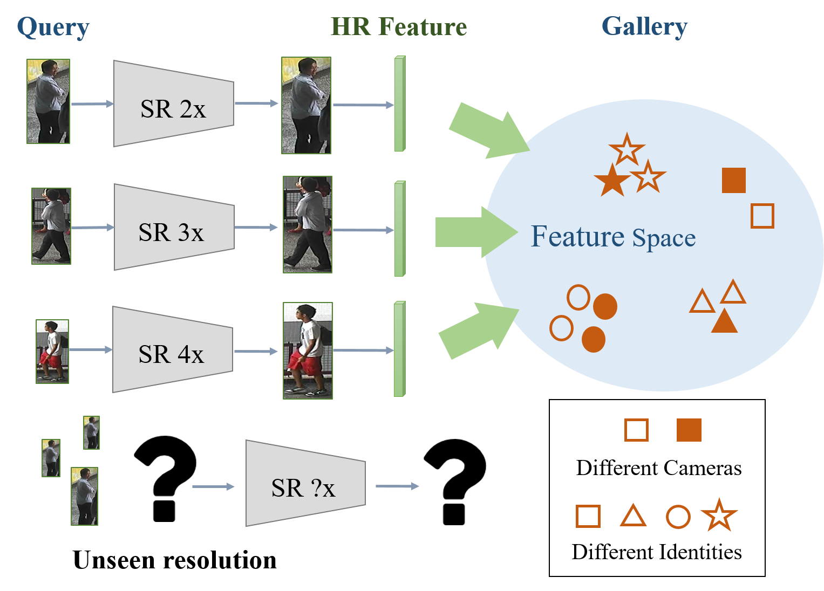
Limitations of Existing Strategies
Unseen resolutions

Slide 9
Our Motivation

Slide 10
Our Motivation: Resolution-Invariant Representations
Query
Resolution-Invariant Representations
Gallery
Encoder
Notes:
給不同resolution query 希望取到相近 甚至幾乎一樣的feature

Slide 11
Resolution Adaptation and re-Identification Network
RAIN

Slide 12
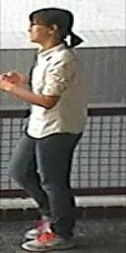

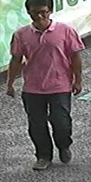


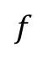
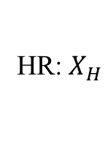
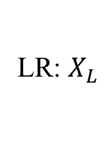
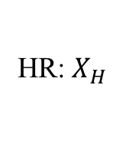
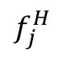
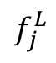
Resolution Adaptation
Cross-Resolution Feature Extractor (F)
HR:${ X}_{H}$
LR:${ X}_{L}$
$$f$$
Resolution Adversarial
Learning
Down-sample
Discriminator (D)
HR:${ X}_{H}$
$$f_{j}^{H}$$
$$D_{j}$$
$$f_{j}^{L}$$
$$ℒ_{adv}$$

Slide 13

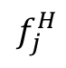
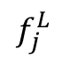

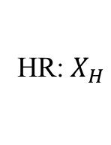
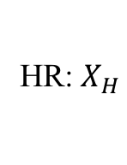
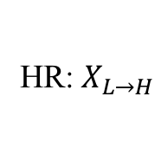
Preserving Image Representation
High-Resolution Decoder (G)
HR:${ X}_{H}$
HR:${ X}_{H}$
$$ℒ_{rec}$$
$$f$$
HR:${ X}_{L→H}$
LR:${ X}_{L}$
$$ℒ_{rec}$$
Down-sample
HR:${ X}_{H}$
$$f_{j}^{H}$$
$$D_{j}$$
$$f_{j}^{L}$$

Slide 14

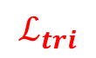
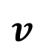
Person Identity Classification
HR:${ X}_{H}$
HR:${ X}_{H}$
$$f$$
HR:${ X}_{L→H}$
LR:${ X}_{L}$
Global Average Pooling
Down-sample
Re-ID Classifier (C)
HR:${ X}_{H}$
$$v$$
Identity Classification
$$f_{j}^{H}$$
$$ℒ_{cls}$$
$$D_{j}$$
$$f_{j}^{L}$$
Intra-/Inter-class Discrepancy
$$ℒ_{tri}$$

Slide 15


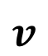

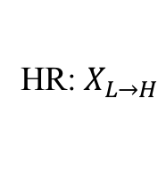

The Proposed RAIN
Cross-Resolution Feature Extractor (F)
High-Resolution Decoder (G)
HR:${ X}_{H}$
HR:${ X}_{H}$
$$ℒ_{rec}$$
$$f$$
HR:${ X}_{L→H}$
LR:${ X}_{L}$
$$ℒ_{rec}$$
Resolution Adversarial
Learning
Global Average Pooling
Down-sample
Re-ID Classifier (C)
Discriminator (D)
HR:${ X}_{H}$
$$v$$
Identity Classification
$$f_{j}^{H}$$
$$ℒ_{cls}$$
$$D_{j}$$
$$f_{j}^{L}$$
Intra-/Inter-class Discrepancy
$$ℒ_{adv}$$
$$ℒ_{tri}$$

Slide 16






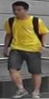





Training Data
HR image set
LR image set
...
...
Down-sample

Slide 17
Evaluation

Slide 18
Implementation Details
Architecture
Cross-resolution feature extractor: ImageNet-pretrained ResNet-50.
Re-ID classifier: a single fully connected layer
Optimizer: stochastic gradient descent (SGD)
Learning rate: 1 $×$ ${10}^{−3}$
Momentum: 0.9
Weight decay: 5 $×$ ${10}^{−4}$
Batch size: 32
Input image size: 256 $×$ 128 $×$ 3

Slide 19
Datasets and Evaluation Metric
Datasets
MLR-CUHK03 [Li et al.]
MLR-VIPeR [Gray et al.]
CAVIAR [Cheng et al.]
Evaluation Metric
Rank
Li et al. Deep-ReID: Deep Filter Pairing Neural Network for Person Re-Identification. In CVPR, 2014.
Gray et al. Viewpoint Invariant Pedestrian Recognition with an Ensemble of Localized Features. In ECCV, 2008.
Cheng et al. Custom Pictorial Structures for Re-Identification. In BMVC, 2011.

Slide 20
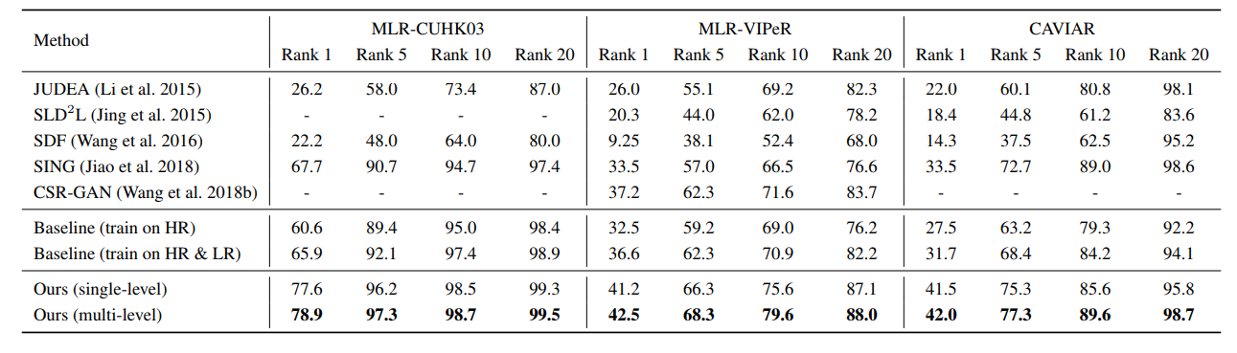
Experimental Results
Li et al. Multi-Scale Learning for Low-Resolution Person Re-Identification. In ICCV, 2015.
Jing et al. Super-Resolution Person Re-Identification with Semi-Coupled Low-Rank Discriminant Dictionary Learning. In CVPR, 2015.
Wang et al. Scale-Adaptive Low-Resolution Person Re-Identification via Learning a Discriminating Surface. In IJCAI, 2016.
Jiao et al. Deep Low-Resolution Person Re-Identification. In AAAI, 2018.
Wang et al. Cascaded SRGAN for Scale-Adaptive Low Resolution Person Re-Identification. In IJCAI, 2018.

Slide 21
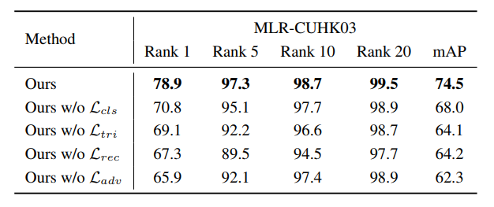
Ablation Study

Slide 22
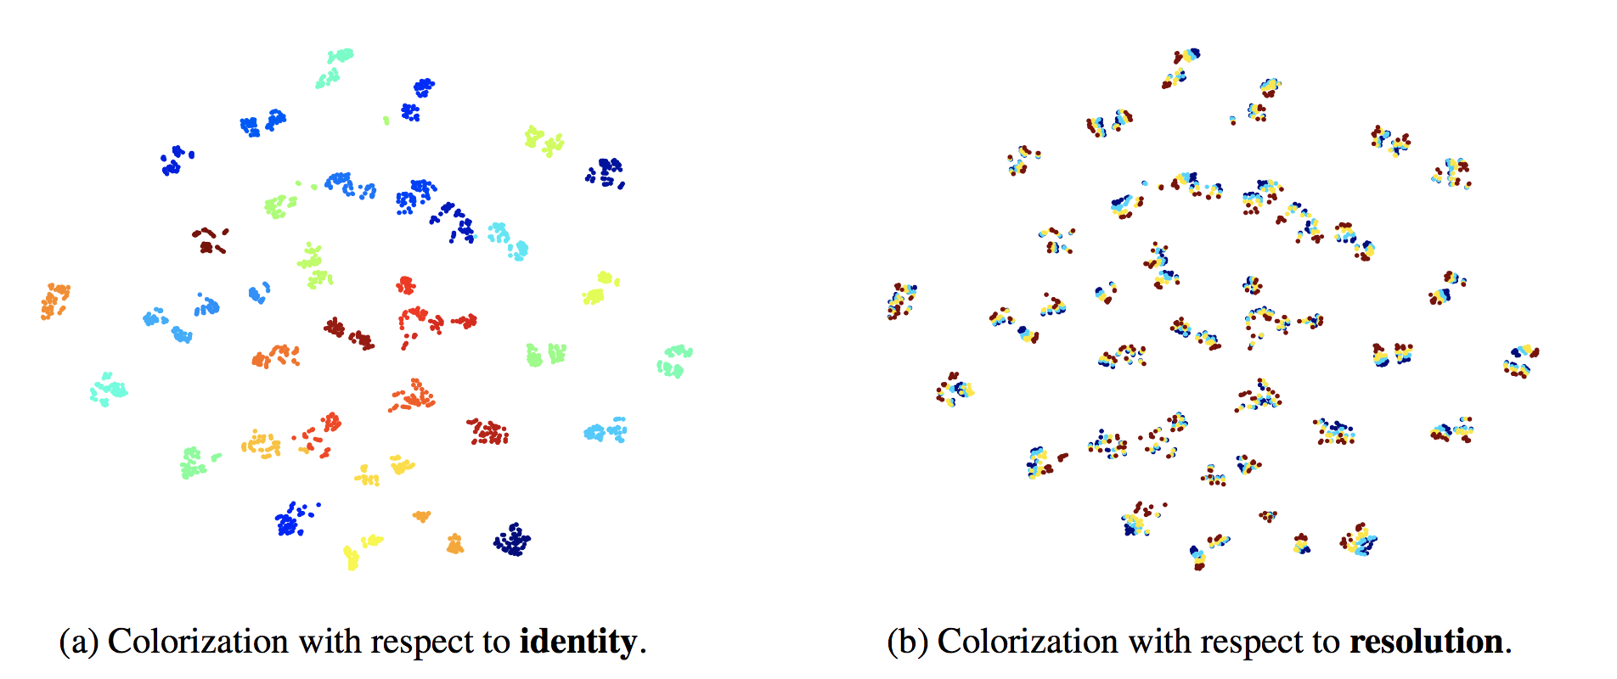
Resolution-Invariant Representations

Slide 23
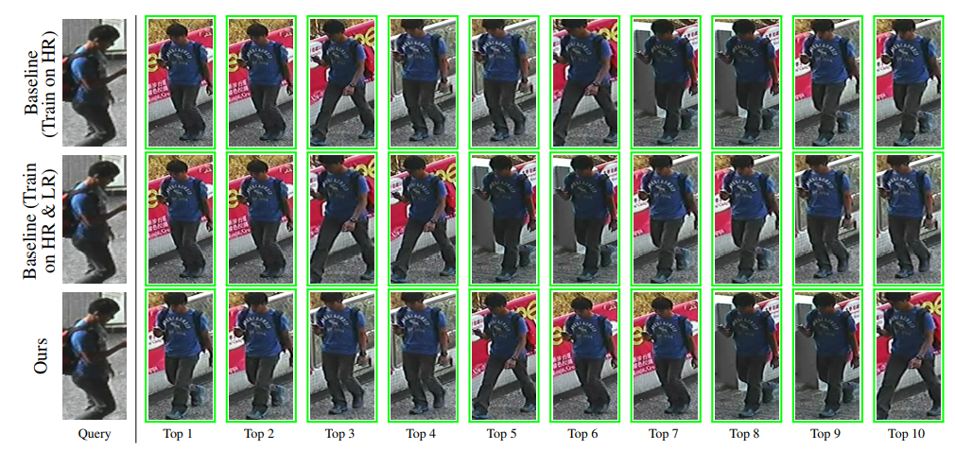
Top-Ranked Gallery Images

Slide 24
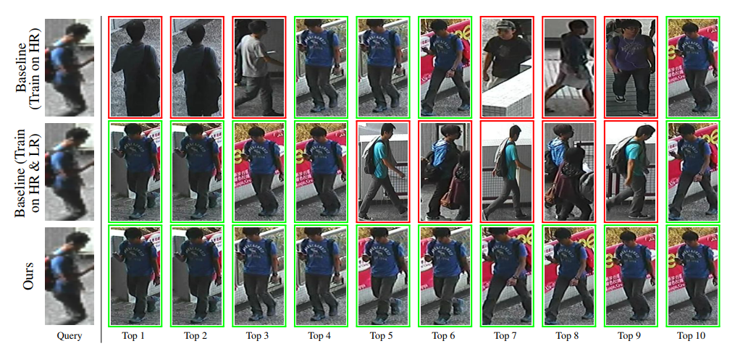
Top-Ranked Gallery Images

Slide 25
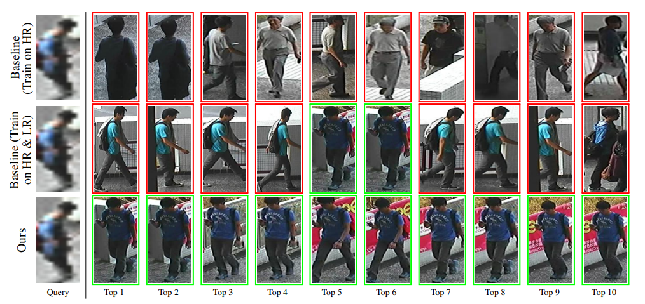
Top-Ranked Gallery Images

Slide 26
Semi-Supervised Results
Ours: 76.1% with 40%
labeled data
SING [Jiao et al.]: 67.7% with 100% labeled data
Jiao et al. Deep Low-Resolution Person Re-Identification. In AAAI, 2018.

Slide 27
Conclusions
Resolution-invariant representations
Multi-level adversarial networks
Handle images of varying and even unseen low resolutions
State-of-the-art performances
Semi-supervised settings

Slide 28
Thanks for listening!

